Slide 1

Wetlands
Presentation By AJ Mabior

Slide 2
What is a wetland?
A natural or manmade area saturated with underground or surface water. Wetlands can be freshwater or saline and are inundated permanently, seasonally or occasionally. These conditions last long enough to create ecosystems adapted to the wet environment.
Department for Environment and Energy (2020)

Slide 3
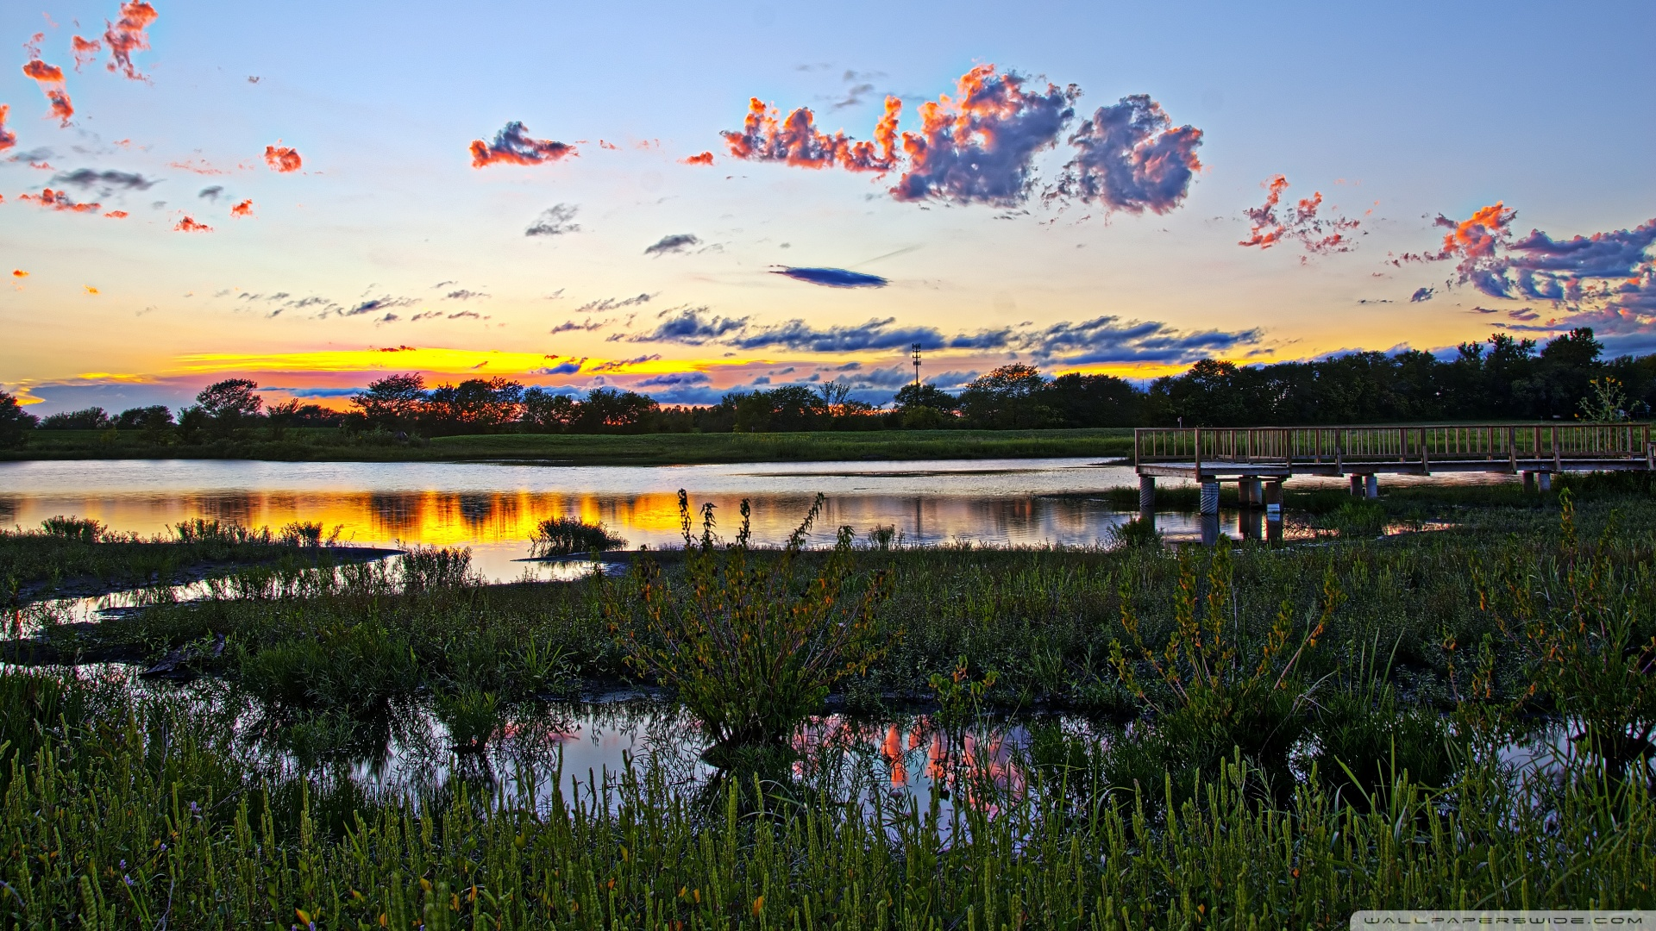

Slide 4
Types of wetlands
Wetlands are categorized into permanently inundated, seasonally inundated, intermittently inundated and occasionally waterlogged. Ground elevation is also considered when categorizing wetlands. They can be formed on basins, channels, flats, slopes or highlands.
Department for Environment and Energy (2020)

Slide 5
Types of wetlands
Some common types of wetlands present in Australia include:
Reserves
Coral reefs
Billabongs
Marshes
Rivers
Mangroves
Department for Environment and Energy (2020)

Slide 6
Why are wetlands important?
Wetlands are crucial in our society. They have practical uses such as drinking, infrastructure and irrigation and can also be culturally significant. Scientists often use wetlands for various form of study. They create habitats for animals and are sometimes crucial in they lifecycles. Wetlands also absorb pollution.
Department for Environment and Energy (2020)

Slide 7
The Ramsar Convention
The Ramsar Convention (signed 1971) contains a criterion used to list international wetlands for preservation. Sites are added if they are significant in their rarity and uniqueness or diversity in their ecology, botany and hydrology. The Ramsar Convention also includes wetlands that support >1% of local species or migratory waterfowls.
Department for Environment and Energy (2020)

Slide 8
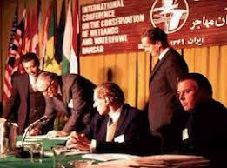

Slide 9
Why is it important?
Intensive agricultural methods and land developments have caused a decrease in wetlands. The Ramsar Convention aims to stop the destruction of wetlands by creating reserves. Wetlands are important not just for our use but because they also create habitats and refuges for animals. They also assist in absorbing pollution from the air.

Slide 10
Lakes Argyle and Kununurra
The Lakes Argyle and Kununurra are Ramsar sites comprised of freshwater reserves. They cover a land area of 177,495 hectares in the northern region of WA. The sites are listed in the Ramsar Convention under the criterions 2, 3, 4 and 5.
Department for Environment and Energy (2020)

Slide 11
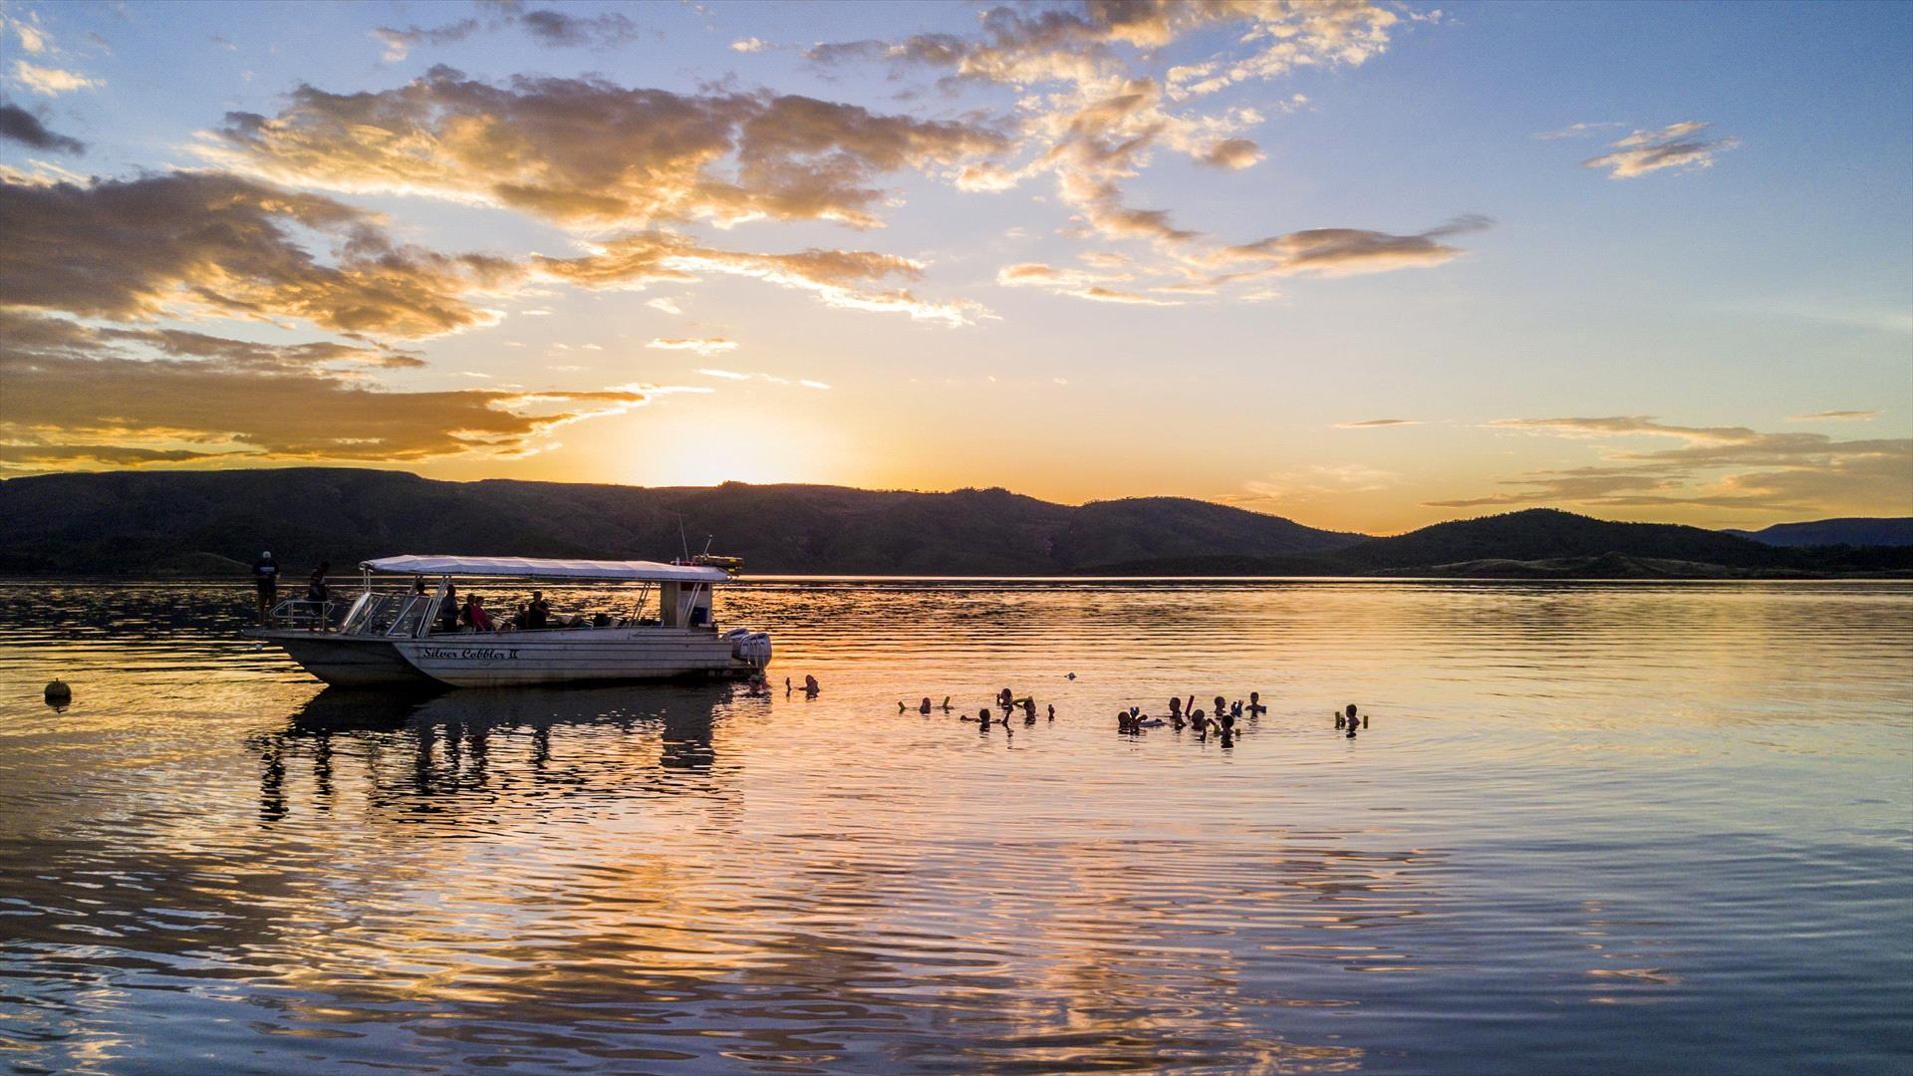

Slide 12
Lakes Argyle and Kununurra
Criterion2: Sustains and maintains nationally listed vulnerable wildlife including freshwater crocodiles.
Criterion 3: Multiple species of fish, turtles, tortoises, waterfowls and retiles inhabit the lakes and surrounding areas in significant populations.
Criterion 4: Plays a critical role in supporting sustaining waterfowls during drought and dry seasons.
Criterion 5: Sustains a significant population of waterfowls. A study in 1986 showed 180,000 birds inhabit the lakes and surrounding areas.
Department for Environment and Energy (2020)

Slide 13
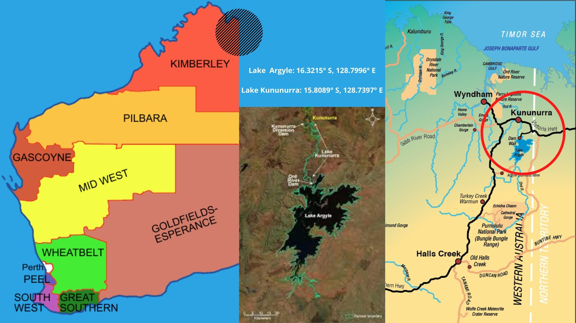
Lakes Argyle and Kununurra
The Lakes Argyle and Kununurra are located in Kimberley, northern WA. They are situated just off the regional town of Kununurra. Lake Kununurra drains into the Timor Sea.

Slide 14
Geography and climate
Lakes Argyle and Kununurra are located in a WA region called Kimberley. This region is part of the tropics so it only displays two seasons, wet and dry season. During the dry season the weather is very predictable; clear skies, wind and temperatures over 40 degress. The wet season is less predictable and more violent; humidity, stagnant air, and prone to cyclones. It rarely rains during the dry season, although 200mm of rainfall can be expected monthly during the wet season.
The Kimberley Climate – Wet Season and Dry Season (2020)

Slide 15
Ecology
While very little plants grow on Lake Argyle, Lake Kununuarra has a wide range of grasslands, marshes and groves. During drought season, an estimated 200,000 waterfowls inhabit the lakes. They are also home to 15 species of fish, various turtles and tortoises as well as fresh water crocodiles. Dead trees are scattered throughout the lakes and have become habitats for schools of fish and tortoises.
Department for Environment and Energy (2020)

Slide 16
Hydrological value
Lakes Argyle and Kununurra are the only source of drinking water for the regional town of Kununurra. Lake Argyle’s water levels fluctuate too drastically to support any large amounts of vegetation, whereas Lake Kununurra is consistent and supports a wide range of vegetation.
Department for Environment and Energy (2020)

Slide 17
Aboriginal heritage
The lakes and surrounding areas are native homes of the Miriuwung and Gajerrong peoples (Native Title Map – Kimberley Land Council, 2020, p.1). In 2003 the federal government recognized the cultural significance of the lakes Argyle, Kununurra and Kununurra town to the inhabiting people. In 2006 The Miriuwung and Gajerrong peoples were also acknowledged as the longest lasting claimants if the land.
Native Title Map – Kimberley Land Council (2020)

Slide 18
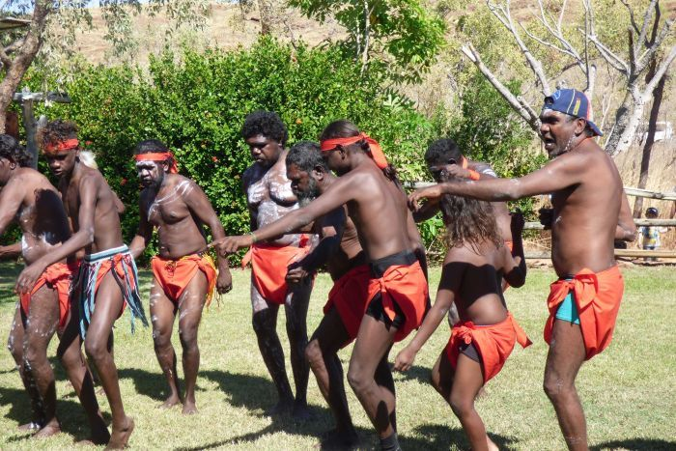

Slide 19
Land development
The lack of suitable land for development in the Kununurra town has led to the expansion of the towns borders into the areas surrounding the lakes Argyle and Kununurra. The areas cleared by the pressures of land development has noticeably displaced animal populations and removed groves, drying up the outskirts of the sites.

